Slide 1

ASSIGNMENT - 1 ECON F215
Suvid Singhal
2023B3A70972P

Slide 2
TABLE OF CONTENTS
01
02
03
04
CONCLUSION
PROBLEM 1
PROBLEM 2
PROBLEM 3
Linear Regression
Logistic Regression
LDA & QDA
Final Remarks

Slide 3
INTRODUCTION
Objective: Use regression and classification models to analyze socioeconomic factors affecting household consumption
Methods: Linear Regression, Logistic Regression, and Discriminant Analysis (LDA & QDA)
Data Source: Household survey dataset (NSSO 68th Round Dataset)

Slide 4
PROBLEM 1
Objective: Determine how land ownership, clothing expenses, and education/medical expenditure influence household expenditure
Method: Multiple Linear Regression (MLR)
Variables:
Dependent: Total Household Expenditure
Independent: Land held, clothing/bedding expenses, education/medical expenses
Initial Findings: Adjusted R² = 0.07 (Low explanatory power)

Slide 5
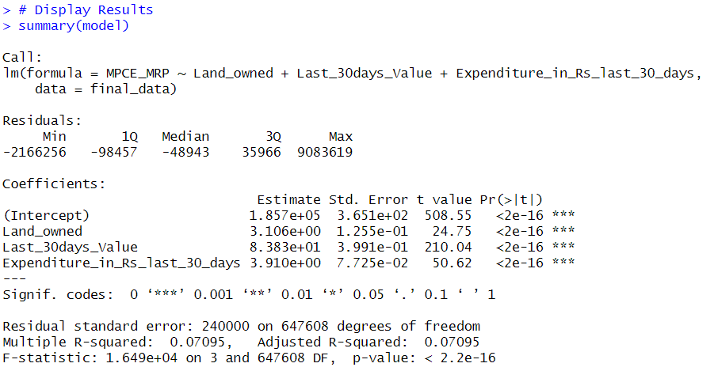

Slide 6
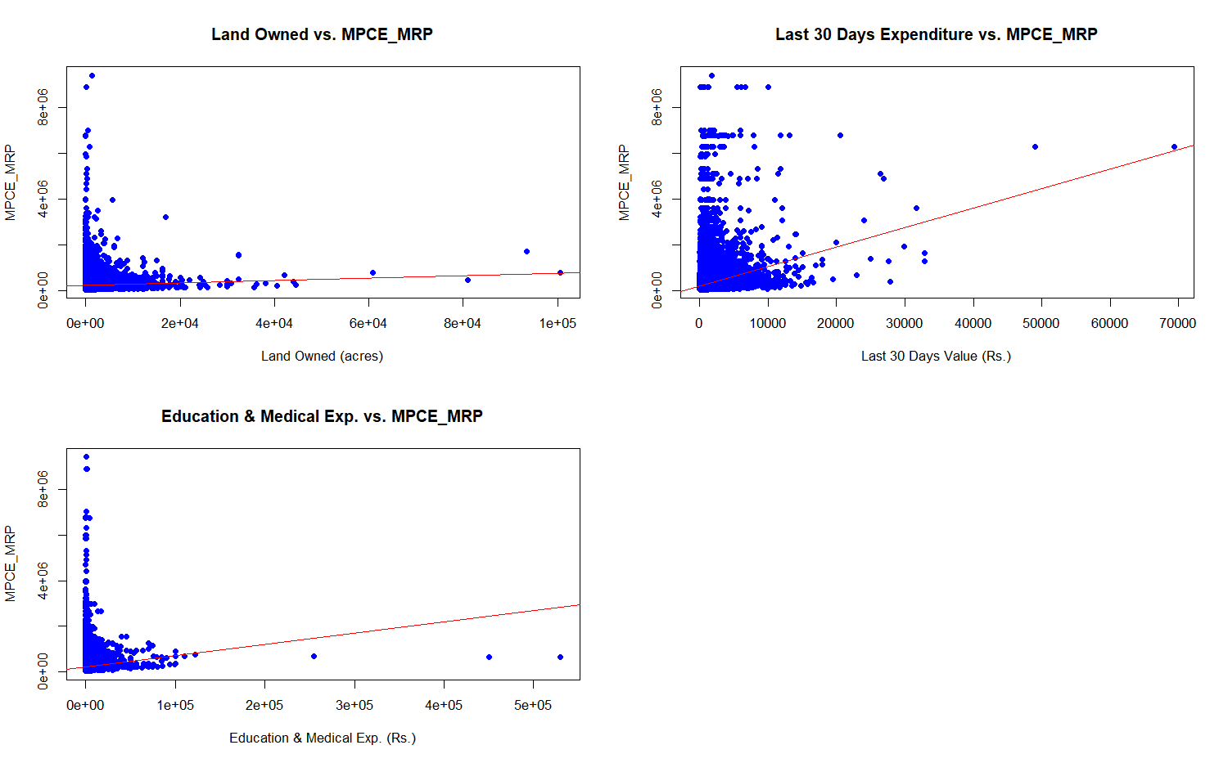

Slide 7
IMPROVEMENTS
Transformation Applied: Log transformation to variables
New Findings: Adjusted R² improved to 0.168
Key Takeaways:
Adding transformations can enhance model performance
Other unaccounted variables may still affect household expenditure

Slide 8
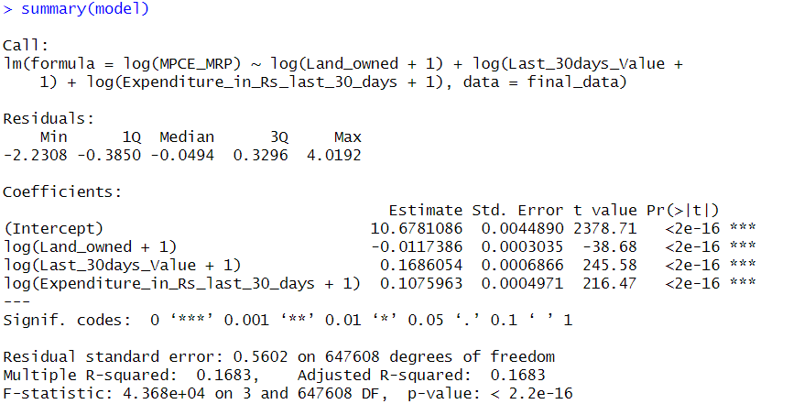

Slide 9
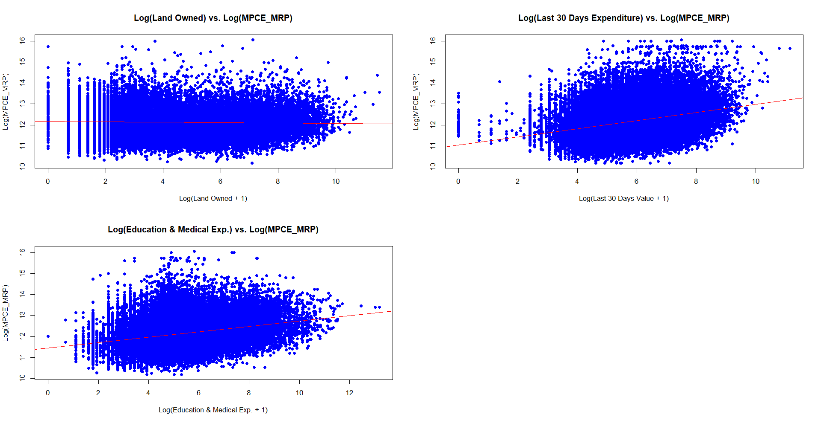

Slide 10
INTERPRETATIONS
Land Ownership: Shows limited impact on household expenditure, possibly due to other wealth indicators
Clothing/Bedding Expenses: Directly influences spending, indicating a clear consumption pattern
Education/Medical Expenses: Impacts spending but might be affected by household priorities
Overall: While the chosen variables contribute a lot, but other factors like income, employment, and savings play a larger role

Slide 11
PROBLEM 2
Objective: Predict whether a household owns land based on household size, type, and occupation
Method: Binary Logistic Regression
Variables:
Dependent: Land Ownership (Yes/No)
Independent: Household size, Household type, Principal Occupation (NCO_2004 Codes)
Threshold for classification: 0.5

Slide 12
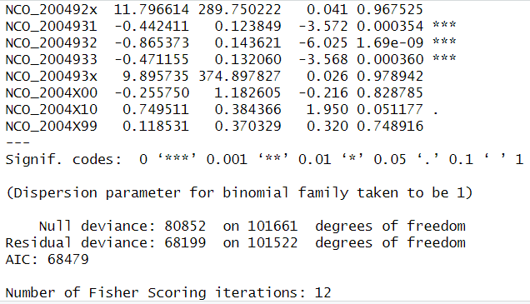
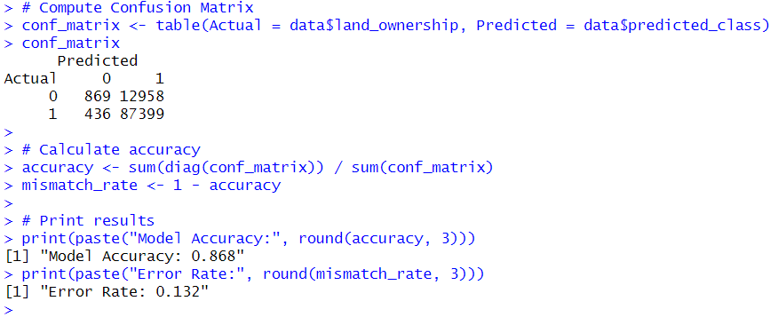

Slide 13
PROBLEM 2
Findings:
Model performed well on training data
Confusion matrix showed moderate misclassification
In the next part, 10% of the dataset was used for testing
Performance slightly decreased (less training data used)

Slide 14
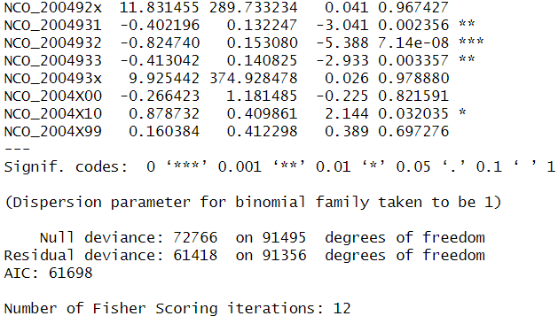
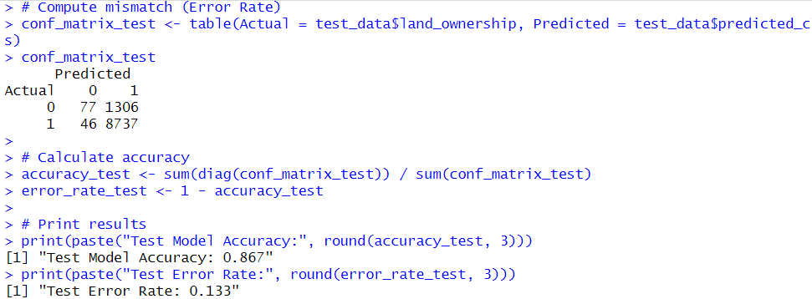

Slide 15
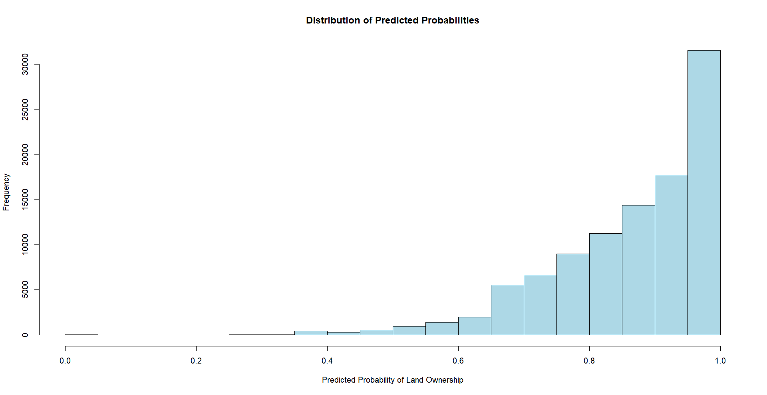

Slide 16
INTERPRETATIONS
Household Size: Larger households tend to own land, suggesting a correlation with generational wealth
Household Type: Certain household structures (e.g., agricultural families) show higher land ownership
Occupation Type: Strong predictor, with agricultural and business households more likely to own land
Overall: While logistic regression provides insights, additional economic variables may improve prediction accuracy

Slide 17
PROBLEM 3
Objective: Predict household cooking fuel choice based on lighting fuel and expenditure
Method: Linear & Quadratic Discriminant Analysis
Variables:
Dependent: Cooking fuel type (Categorical, K > 2)
Independent: Lighting fuel type, MPCE_MRP (Monthly expenditure)

Slide 18
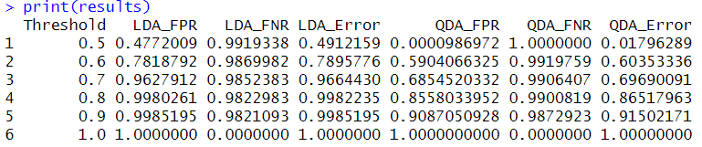
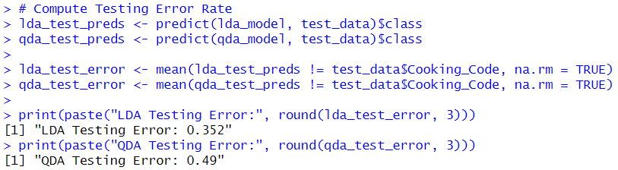
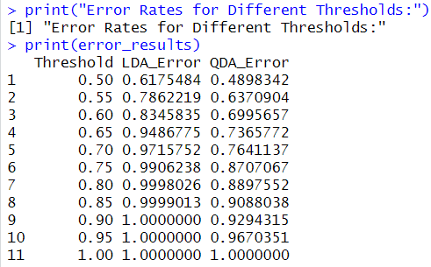

Slide 19
PROBLEM 3
Evaluation:
Testing error rates for LDA & QDA were analyzed
Error rates increased as threshold was made stricter (0.5 to 1)
Problems Faced:
Had to go through a lot of variables to select perfect one for QDA as classes were highly imbalanced in most of the variables

Slide 20
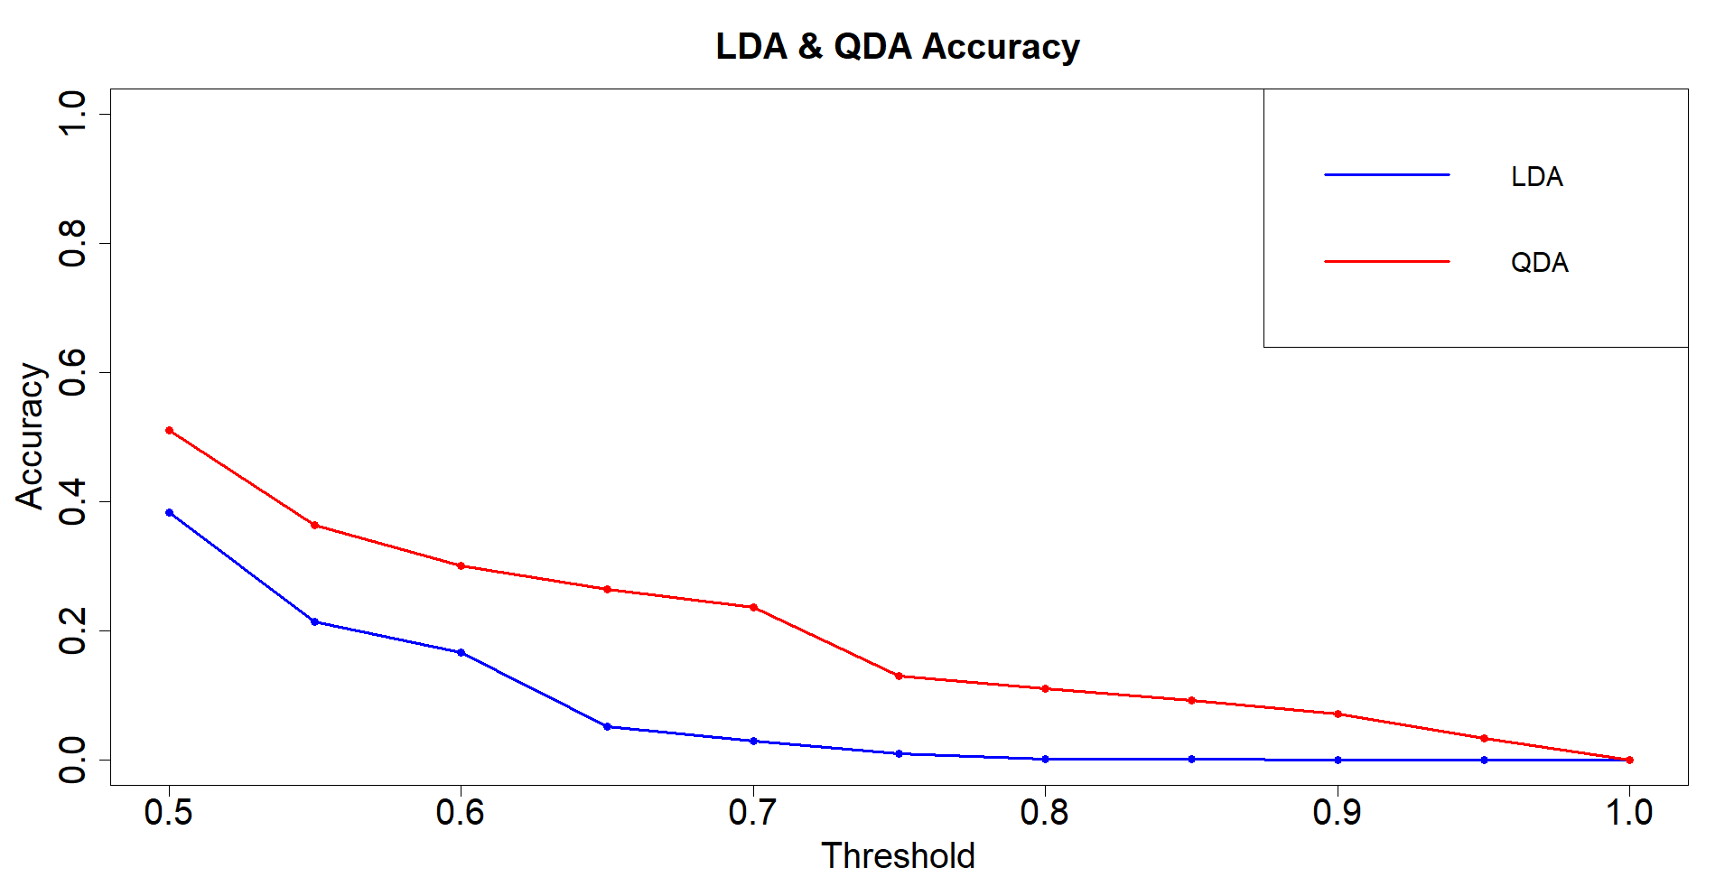

Slide 21
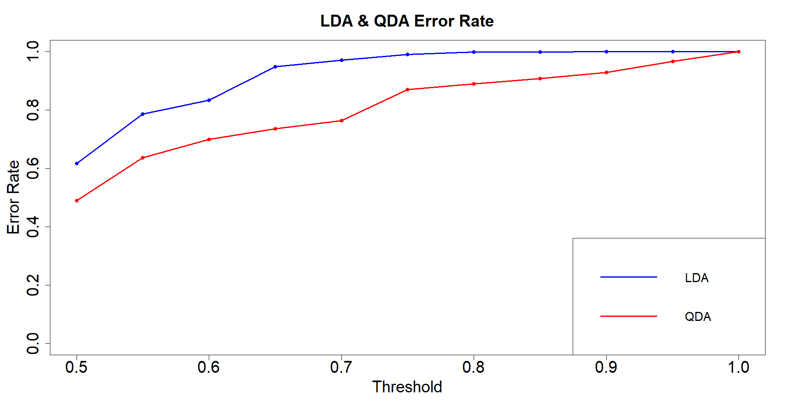

Slide 22
INTERPRETATIONS
Lighting Fuel Type: Strong predictor of cooking fuel choice, possibly due to infrastructure constraints
Expenditure (MPCE_MRP): Higher income groups tend to use cleaner fuels, indicating an affordability factor
LDA vs. QDA: QDA performed better in capturing non-linear relationships, highlighting complex dependencies
Overall: Policy implications of the study include targeted subsidies and infrastructure support for clean energy transitions

Slide 23
CONCLUSION
Key Takeaways:
Linear Regression: Household expenditure is influenced but not fully explained by selected variables
Logistic Regression: Land ownership can be predicted with moderate accuracy using household characteristics
LDA & QDA: Cooking fuel choice is significantly affected by lighting fuel and expenditure, with thresholds impacting classification.
Future Scope: More variables and feature engineering could improve model performance

Slide 24
THANK YOU

